Slide 1
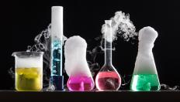
New Substances
Chapter 13.1

Slide 2
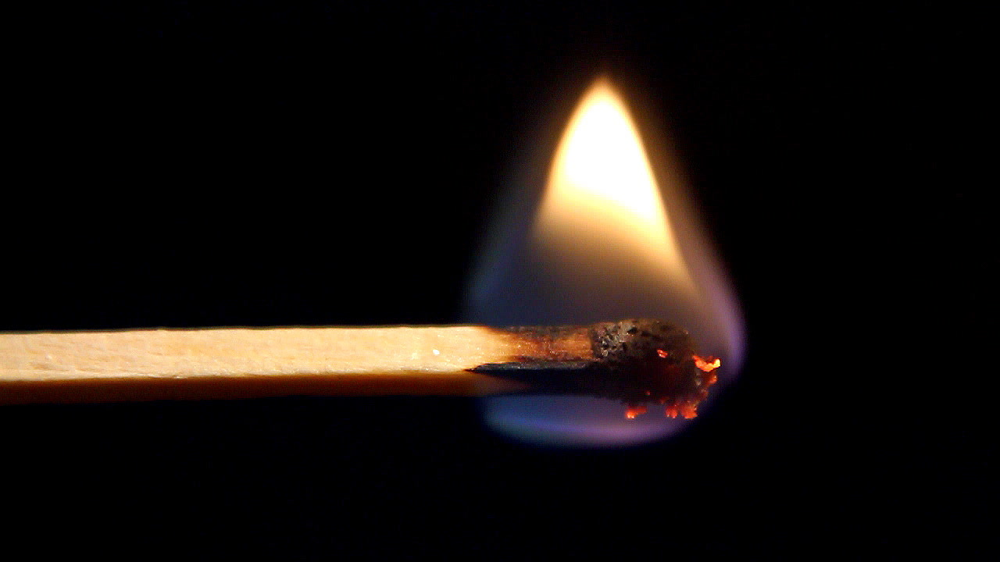
Key concepts:
Describe how chemical reactions produce new substances that have different chemical and physical properties
Identify four signs that indicate that a chemical reaction might be occurring
Explain what happens to chemical bonds during a chemical reaction.

Slide 3
Key Vocabulary:
Chemical reaction
Precipitate

Slide 4
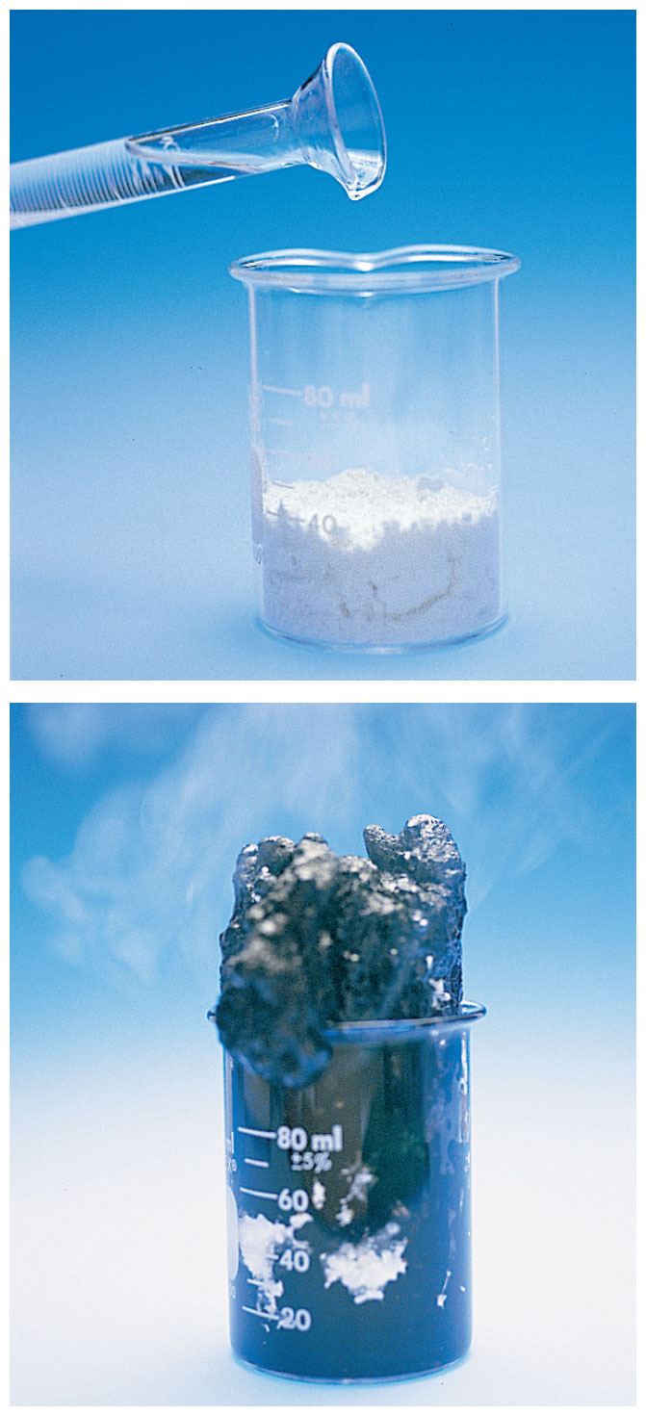
New Properties:
Chemical change = NEW substance = NEW properties
Think about what happens to sugar when you cook it…
Chemical Reaction = Chemical change

Slide 5
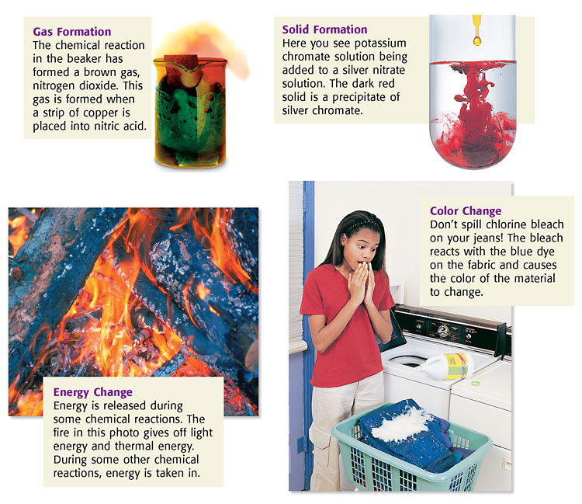

Slide 6
Chemical Change
A chemical reaction is a process in which one or more substances change to make one or more new substances.

Slide 7
Chemical Change
Signs that a chemical change may have taken place
Color change
Absorption or release of energy
Odor
Formation of gases
or solids
Can’t be reversed

Slide 8
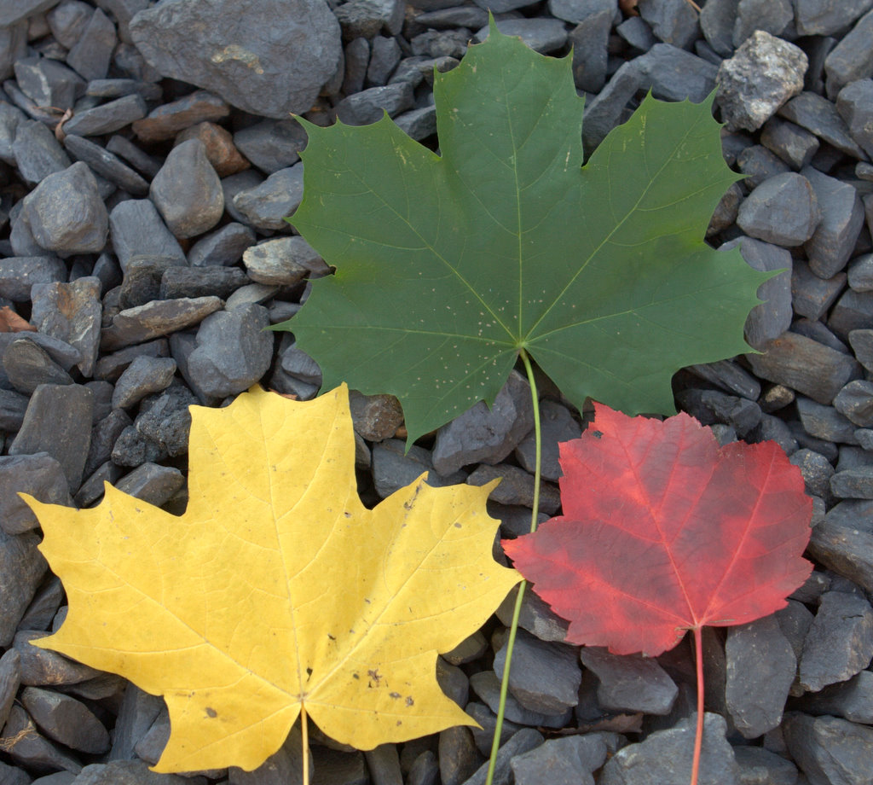
Signs of chemical changes
The best sign of a chemical change is that at the end-you have a new substance!
Other common signs:
Color change

Slide 9
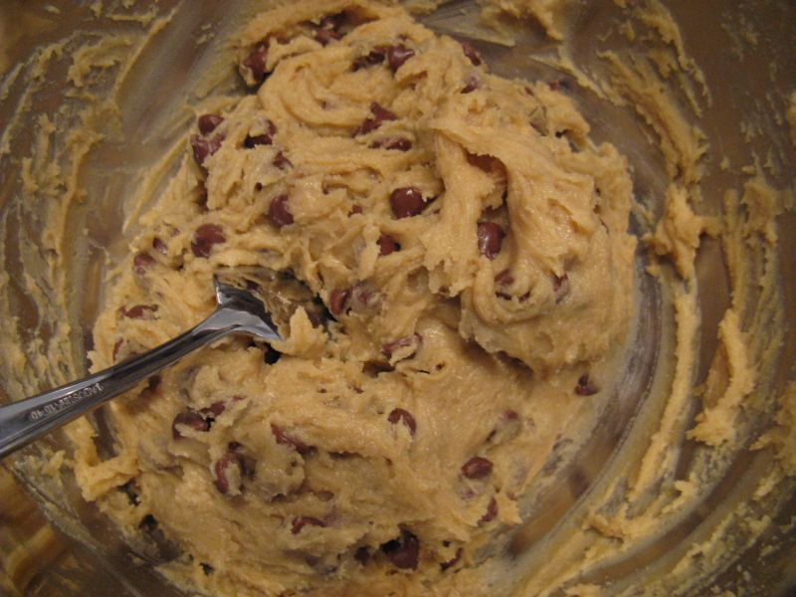
More signs of a chemical change
Takes energy or releases energy (cooking, burning, produced light, electricity, fireworks)
Before- mixing all of the ingredients, I could get all of the pieces back, so stirring together is a physical change

Slide 10
After I put the batter in the oven, the energy changes the make-up of the matter, I can not get batter back!

Slide 11
Releasing energy
Before: nothing in the sky (this was difficult to make)
And after- fireworks!!!! Release energy as heat and light

Slide 12
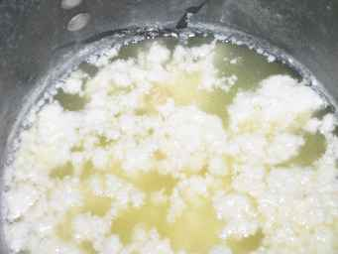
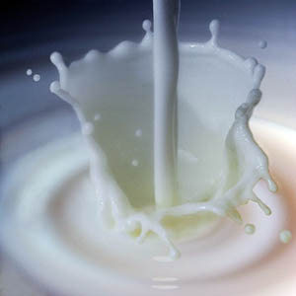
More signs of a Chemical Change
Change in smell or odor
Rotten milk- I hope you never smell this!
Yummy milk- fresh from the cow (or super market)

Slide 13
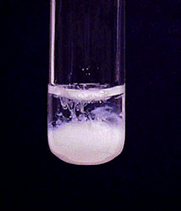
Last sign of a chemical change
Making a gas or a solid without the use of energy
Precipitate: formation of a solid
Ammonium carbonate precipitates white SrCO₃. Sr²⁺(aq) + CO₃²⁻(aq) <==> SrCO₃(s)

Slide 14
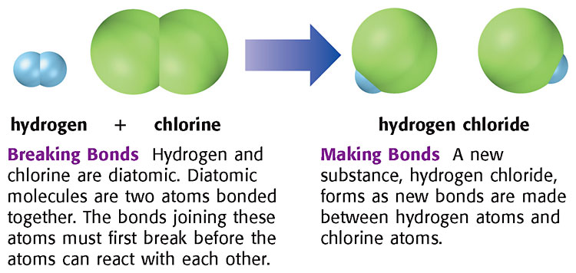
Bonds:
Chemical bonds in the starting substances must break.
Molecules are always moving, and if there is enough energy, the chemical bonds in the molecules break.

Slide 15
Making new substances
The atoms then rearrange, and new bonds form to make the new substances.
The substances formed in the following reaction are very different from the starting substances
https://www.youtube.com/watch?v=BXZ8M2qHi0g

Slide 16
What you learned:
A chemical reaction is a process by which substances change to produce new substances with new chemical and physical properties.
Signs that indicate a chemical reaction has taken place are a color change, formation of a gas or a solid, and release of energy.
During a reaction, bonds are broken, atoms are rearranged, and new bonds are formed.

