Slide 1
Interactive
Science
Notebooks
(ISNs)
Presented by: Mrs. L. George
7th &8th Grade Science

Slide 2
Have you ever heard yourself say ... ?
I can't remember what
we did in class yesterday.
I can't find my . . .
notes, homework, quizzes . . .
I'm sure it’s in . . .
my locker? my book bag? my room?
I was absent last week,
did I miss anything?
Source: Gretchen Vikingson at http://vikingson.edublogs.org/files/2011/07/2011-2012-INB-student-version-2afd6sb.ppt

Slide 3

No worries …
Turn those frowns upside down …
Interactive Science Notebooks
are here to save the day!

Slide 4
What Is An Interactive Science Notebook?
An interactive science notebook (ISN) is your own personalized SCIENCE BOOK.
A portfolio of your work in ONE spot that you USE EVERY DAY. This is a great resource for STUDYING for quizzes & tests.
A great ORGANIZATIONAL tool that gives you permission to be COLORFUL and CREATIVE to show me what you know or have learned.
Allows you to be like a REAL SCIENTIST by asking QUESTIONS, RECORDING what you observe, and SHARING it with your classmates!
Source: Gretchen Vikingson at http://vikingson.edublogs.org/files/2011/07/2011-2012-INB-student-version-2afd6sb.ppt

Slide 5



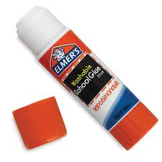
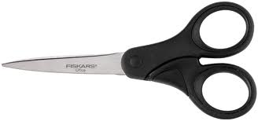
Science Notebook Supplies
Colored Pencils
Pens & Pencils
3 Subject Spiral Notebook
Scissors
Glue Stick
NO MARKERS!
(except on the covers)

Slide 6
The ISN is divided into TWO sections:
Left Side
Right Side
“LOVES” YOUR work. This is the side that you can use to show me what you learned
in a creative and colorful way.
This is the “output” or product side.
Even-numbered pages
“RESTRICTED” to
Mrs.George’s input work
Contains info my teacher tells me to “ADD” or “WRITE”
This is the “input” side or info side.
Odd-numbered pages
Source: Gretchen Vikingson at http://vikingson.edublogs.org/files/2011/07/2011-2012-INB-student-version-2afd6sb.ppt

Slide 7
What Goes Where?
Left Side
Student Output
Lots of Color, Diagrams, & Doodles
Concept Maps/Organizers
Drawings
Reflective Writing
Questions
Data Charts and Graphs
Songs, Poems, or Riddles
Data from Experiments
Cartoons or cartoon strips
“Do Now” (Top of Page)
Right Side
Teacher Input/Content
Ink or Pencil
Information given in class
Lecture Notes
Lab Activities
Video Notes
Summaries
Textbook Notes
Procedures for experiments
Classroom Specific Information
Source: http://www.slideshare.net/arholder/interactive-science-notebook-full-version

Slide 8
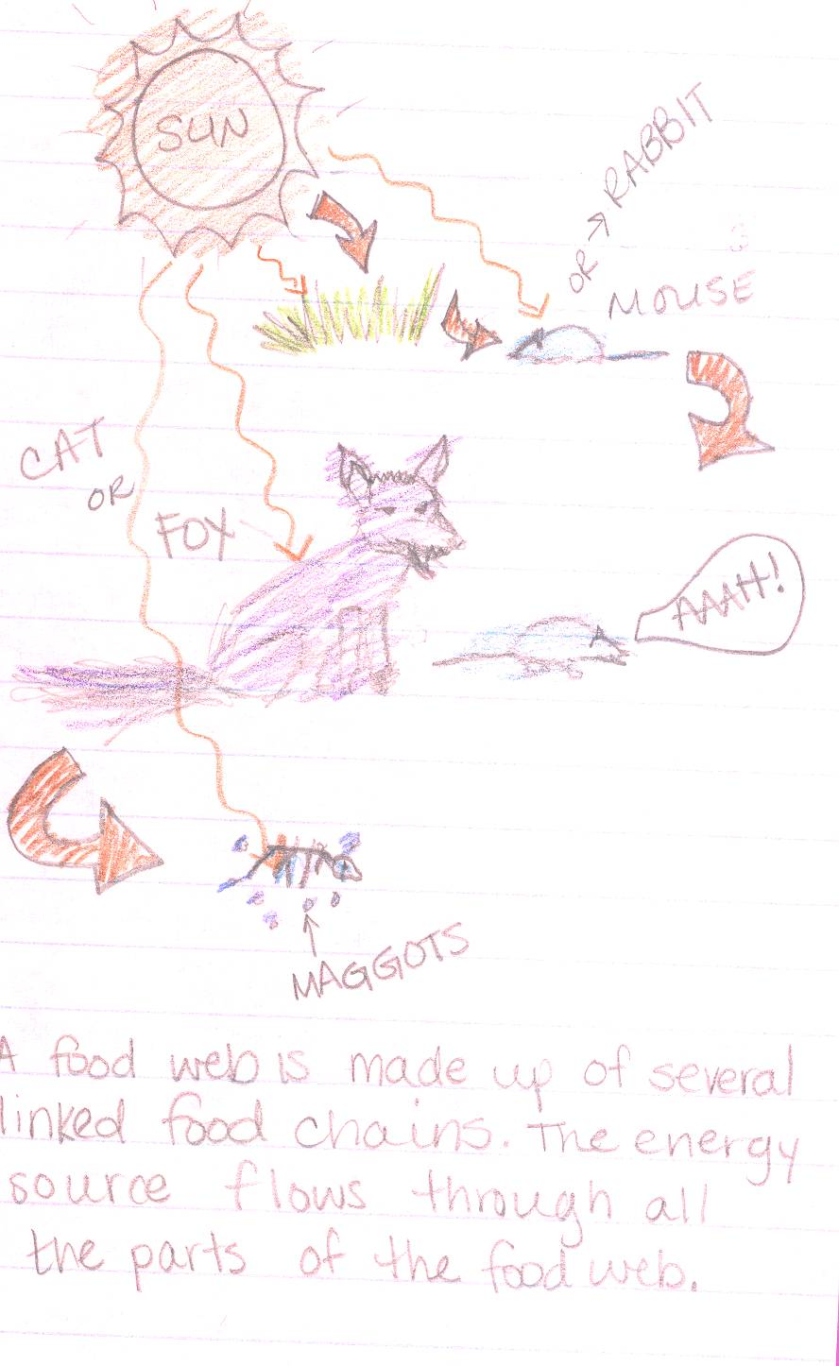
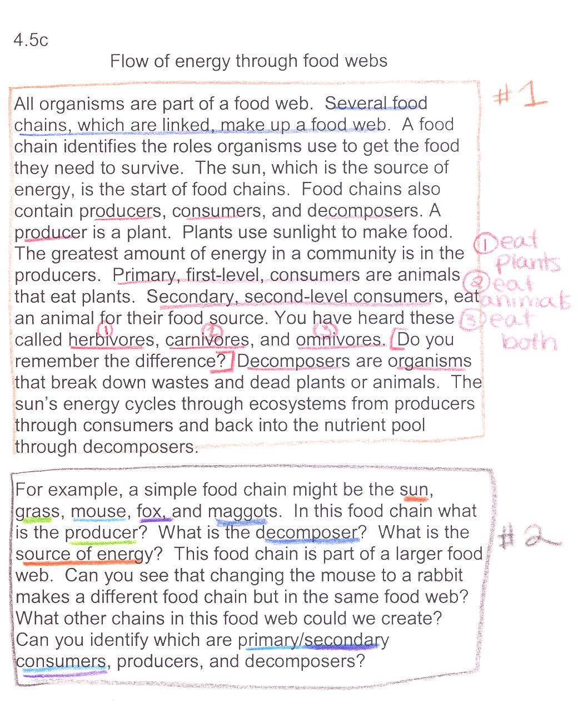
Example page:
OUTPUT
(your interpretation)
INPUT
(notes from teacher)
Source: http://www.slideshare.net/arholder/interactive-science-notebook-full-version

Slide 9
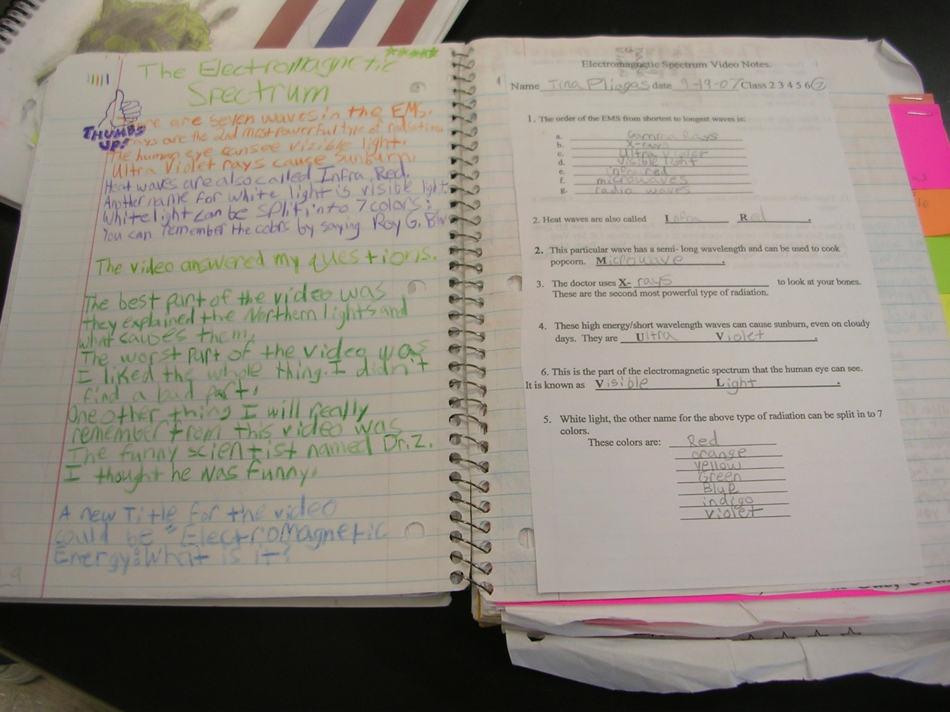
OUTPUT
(your interpretation)
INPUT
(notes from teacher)
Source: http://www.slideshare.net/arholder/interactive-science-notebook-full-version

Slide 10

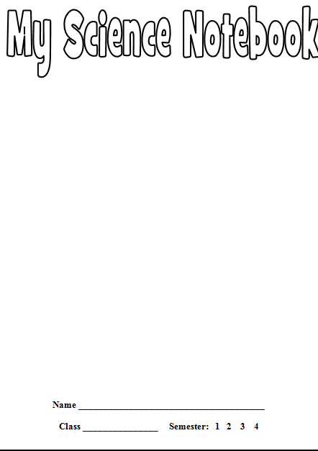
Step 1: Getting Started
1 – Fill out the info slip and glue it in the front of the cover.
2 – Add pictures of your favorite science things.
You may draw them or use images you find online.
(Complete for homework)

Slide 11

Step 2: Page Numbers
Add PAGE NUMBERS for the first fifty (50) pages.
Start with 1 in the bottom-right corner of the first page, follow with a 2 on the back of that page and so on. Use Pen Only- Dark blue or black
EVENS
ODDS

Slide 12
Step 3: Table of Contents
Start at page number 1 and write the title TABLE OF CONTENTS.
You will use the first five pages, 1-10, (front and back). In the table of contents you will include the date, title, page number, and grade/ stamp. You may skip one line in-between each assignment.

Slide 13
TABLE OF CONTENTS
DATE | Title | PAGE # | Grade/ Stamp
8-10 | Pretest lab safety
8-10 | Lab safety rules
8-11 | Do now
8-12 | Lab safety quiz

Slide 14
Step 4: Add Glossary
Count 10 pages from the back and add the title Glossary.
Using a ruler draw a line down the middle. On the left side goes the word and definition. On the right side goes a picture of how you interpret the word.
Glossary
EVENS
ODDS

Slide 15
Glossary
Word/Definition | Picture

Slide 16
Notebook Rules
Do not RIP OUT pages or tear corners.
All handouts MUST BE GLUED/TAPED IN!
Please don’t DOODLE unless it relates to science.
Your ISN should only be used for SCIENCE CLASS and USED IN CLASS EVERYDAY!
Each page should have the DATE and PAGE#.
BE COLORFUL, CREATIVE, & LOVE YOUR NOTEBOOK!
Source: Gretchen Vikingson at http://vikingson.edublogs.org/files/2011/07/2011-2012-INB-student-version-2afd6sb.ppt

Slide 17
QUESTIONS?

Slide 18
Let’s Use Your ISN
Concept Mapping (Graphic Organizer) goes on page number 10.
Directions goes on page 11.
Title: “ All About Me”
Directions: Make a concept map of yourself including 10 facts about you. You can draw a picture or find one from the internet, magazine or other source. The only picture that cannot be drawn is the one of you. The concept map should begin with your picture and name in the center of it. Last but not least, make your concept map colorful (colorful pictures may suffice).
(Complete for homework)

Slide 19
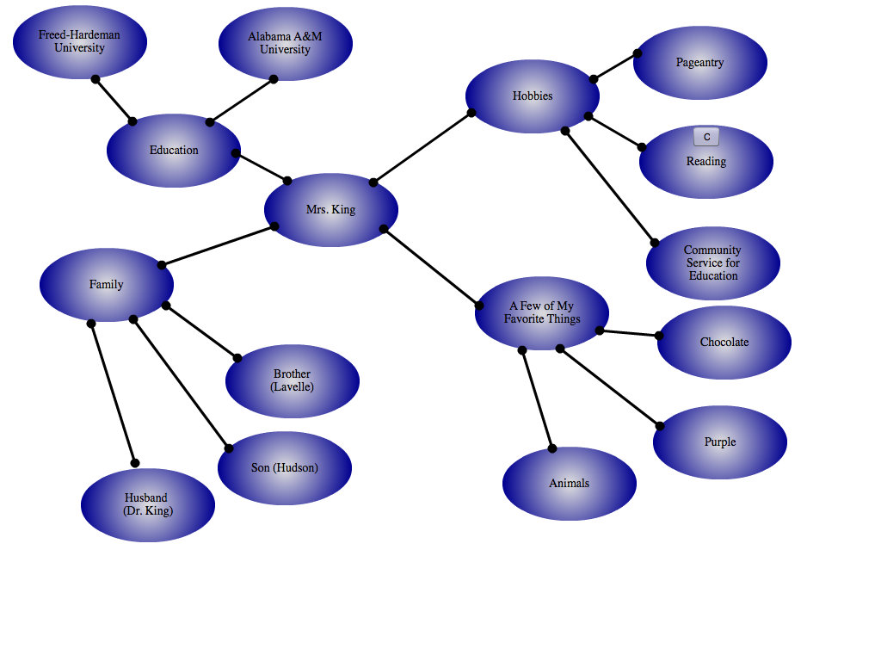
All About Me concept Map

Slide 20
CONCEPT MAP
Mrs. George
Family
Favorite things
Hobbies
Crocheting
George (husband)
Brandon
Mitchell
Tristin
Chocolate
Dr. Who
Reading
Ashley
Jaden and Aria

